Slide 1

Expense tracker system
Presentation for Software Engineering class

Slide 2
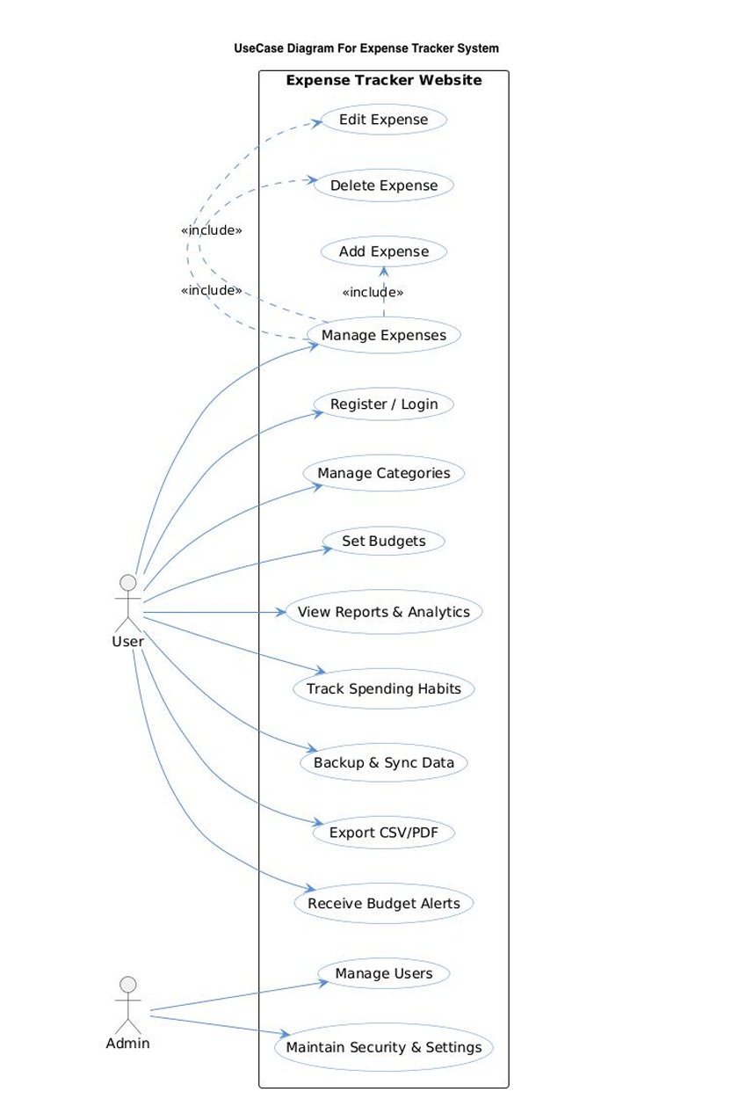

Slide 3
A use case diagram is a type of diagram used in software engineering (specifically in Unified Modeling Language or UML) to show how different users interact with a system
The Use Case Diagram of the Expense Tracker Website shows how users and admins interact with the system. The main actor is the User, who can register/login, manage expenses, create categories, set budgets, view reports and analytics, track spending habits, sync and backup data, export reports, and receive budget alerts. Expense management includes adding, editing, and deleting expenses. The Admin actor manages users and maintains system security and settings. The diagram presents the main functionalities of the website in a simple and organized way, showing the relationship between users and system features.

Slide 4
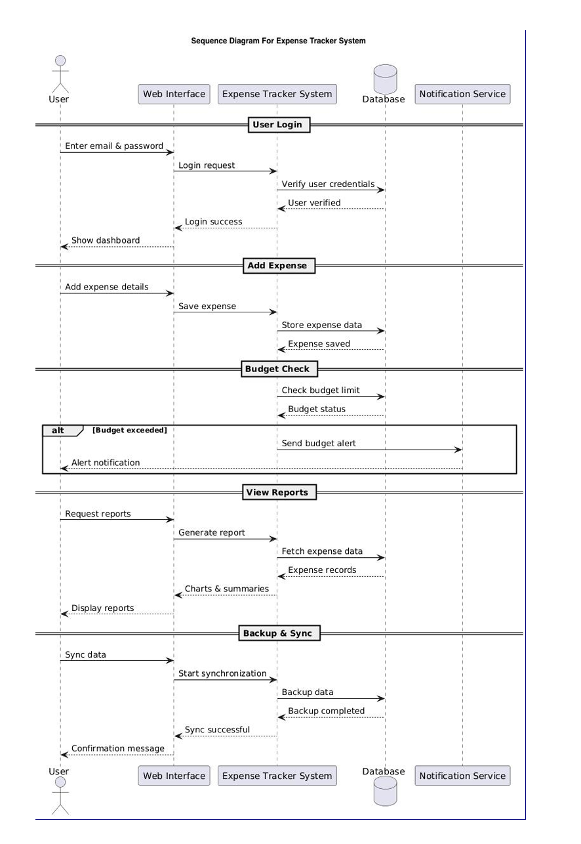

Slide 5
A sequence diagram is a type of UML diagram that shows how objects or users interact with each other in a specific order over time.
The sequence diagram shows how the user interacts with the Expense Tracker Website step by step. First, the user logs into the system, and the system verifies the credentials using the database. The user can then add expenses, which are stored in the database. The system checks the budget limit and sends alerts if the budget is exceeded. Users can also request reports, where the system retrieves expense data and displays charts and summaries. Finally, the system supports backup and synchronization of data across devices.

Slide 6
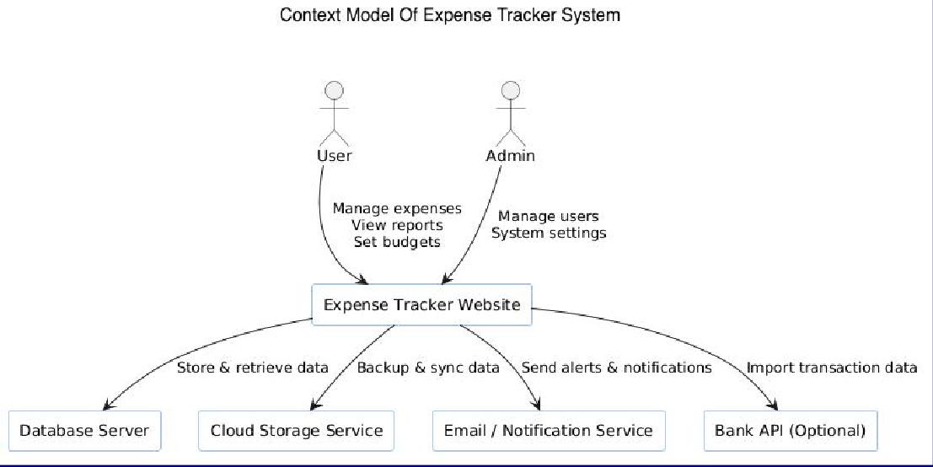
The context model shows the Expense Tracker Website as the central system interacting with external entities. Users interact with the system to manage expenses, budgets, and reports, while the Admin manages users and system settings. The system communicates with the Database Server to store and retrieve data, Cloud Storage for backup and synchronization, Email/Notification Service for alerts, and an optional Bank API for importing transaction data.
A context model (or context diagram) is a high-level diagram that shows a system and its interaction with external entities such as users, organizations, or other systems.

Slide 7
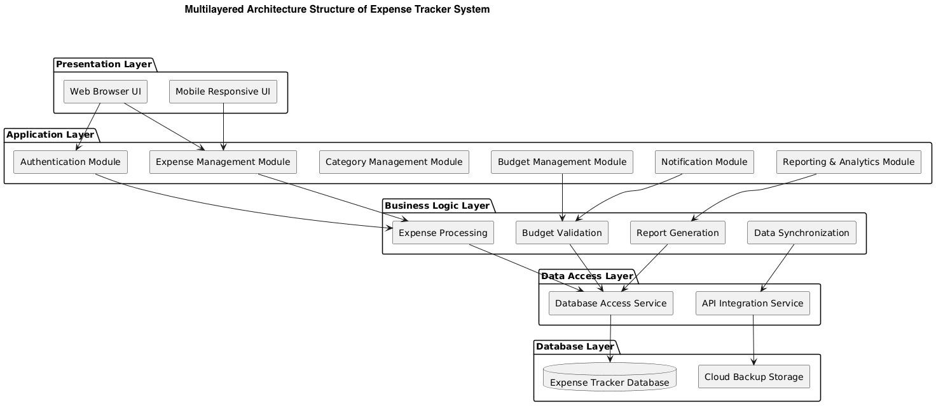
The multilayered architecture diagram divides the Expense Tracker Website into different layers for better organization and maintainability.
Presentation Layer: Provides the user interface through web browsers and mobile-responsive pages.
Application Layer:
Handles main system modules such as authentication, expense management, budgeting, reporting, and notifications.
Business Logic Layer: Processes expenses, validates budgets, generates reports, and manages synchronization logic.
Data Access Layer: Connects the system with databases and external
APIs.
Database Layer: Stores expense data and cloud backup information. This layered structure improves scalability, security, maintainability, and system performance.

Slide 8
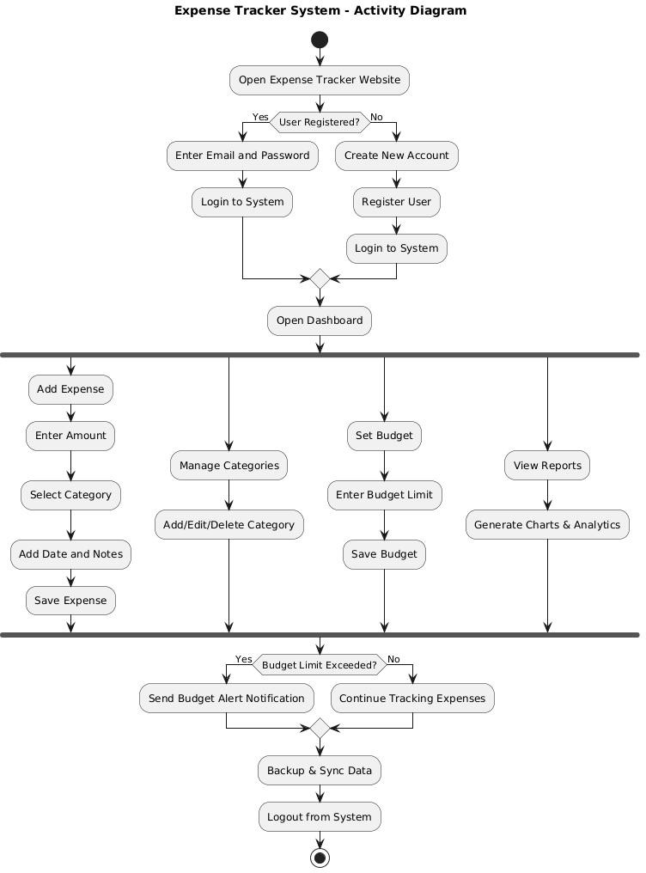
The activity diagram of the Expense Tracker System shows the complete workflow of the application, starting from user login or registration to managing expenses, categories, budgets, and reports. After accessing the dashboard, users can add and save expenses, manage expense categories, set budget limits, and view charts and analytics. The system then checks whether the budget limit has been exceeded and sends alerts if necessary. Finally, the system backs up data, the user logs out, and the process ends. Overall, the diagram explains the sequence of user activities and system operations in a clear and organized way.

Slide 9
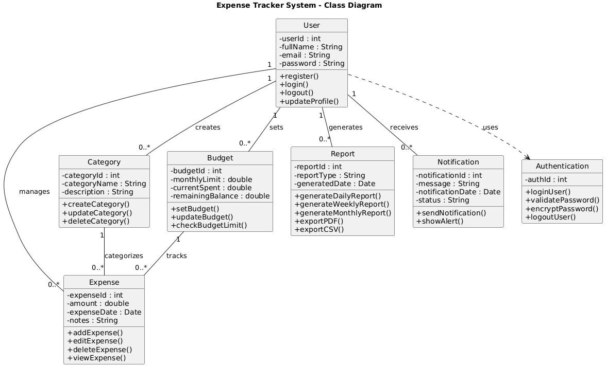

Slide 10
A class diagram is a type of UML (Unified Modeling Language) diagram used to represent the structure of a system by showing its classes, attributes, methods, and relationships between classes.
The image shows a Class Diagram of an Expense Tracker System that represents the static structure of the application using different classes, their attributes, methods, and relationships. The main class is the User class, which manages activities such as registration, login, logout, and profile updates. The user interacts with other classes including Expense, Category, Budget, Report, Notification, and Authentication. The Expense class stores expense details and allows adding, editing, deleting, and viewing expenses, while the Category class organizes expenses into different categories. The Budget class manages monthly spending limits and tracks remaining balance. The Report class generates daily, weekly, and monthly reports and supports exporting data in PDF or CSV format. The Notification class sends alerts and notifications to users, especially for budget-related updates. The Authentication class handles login validation and password security. The relationships in the diagram show how users manage expenses and categories, set budgets, generate reports, and receive notifications, illustrating the overall structure and interaction of the Expense Tracker System.
Class Diagram

Slide 11
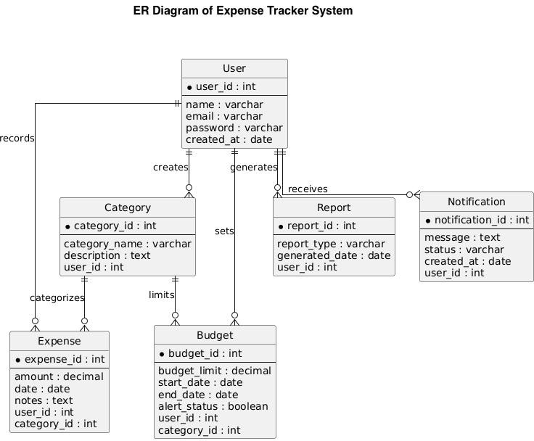
An ER Diagram (Entity Relationship Diagram) is a visual representation of a database structure that shows entities, attributes, and relationships between data in a system.
The ER Diagram of the Expense Tracker System illustrates the database structure and relationships between different entities in the system. The main entities include User, Expense, Category, Budget, Report, and Notification. The User entity stores user information and is connected to other entities because a user can create categories, record expenses, set budgets, generate reports, and receive notifications. The Expense entity stores expense details such as amount, date, and notes, while the Category entity organizes expenses into different groups. The Budget entity manages spending limits for users and categories, and the Report entity stores generated report information. The Notification entity handles alert messages and status updates. Overall, the ER diagram represents how data is organized, stored, and related within the Expense Tracker System database

Slide 12
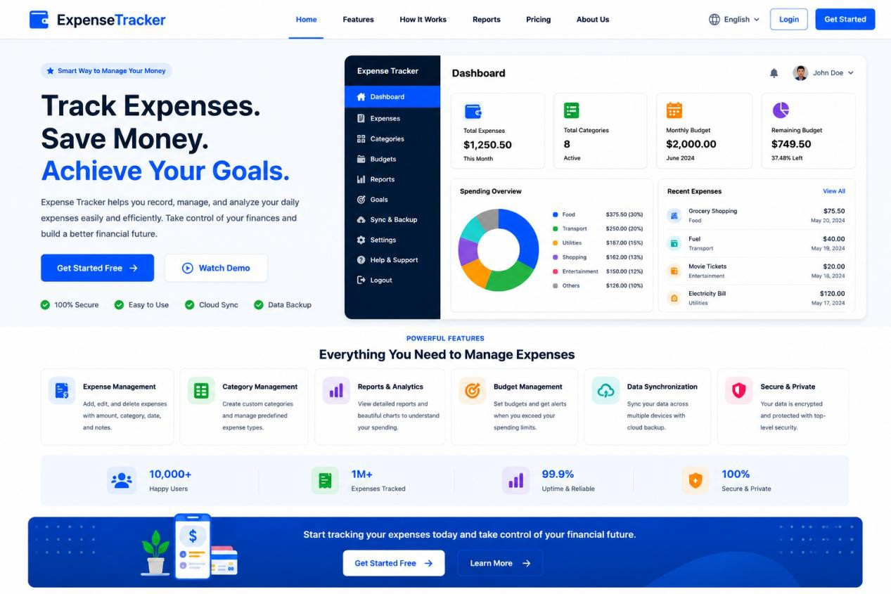
The image shows a modern and professional landing page design for an Expense Tracker website. The page includes a clean navigation bar, a large hero section with the heading “Track Expenses, Save Money, Achieve Your Goals,” and action buttons like “Get Started Free” and “Watch Demo.” On the right side, a dashboard preview displays expense statistics, budget information, charts, and recent expenses. Below the hero section, the page highlights key features such as expense management, category management, reports and analytics, budget management, data synchronization, and security. The design uses a blue-and-white color theme with a simple, user-friendly layout focused on financial management and expense tracking

Slide 13
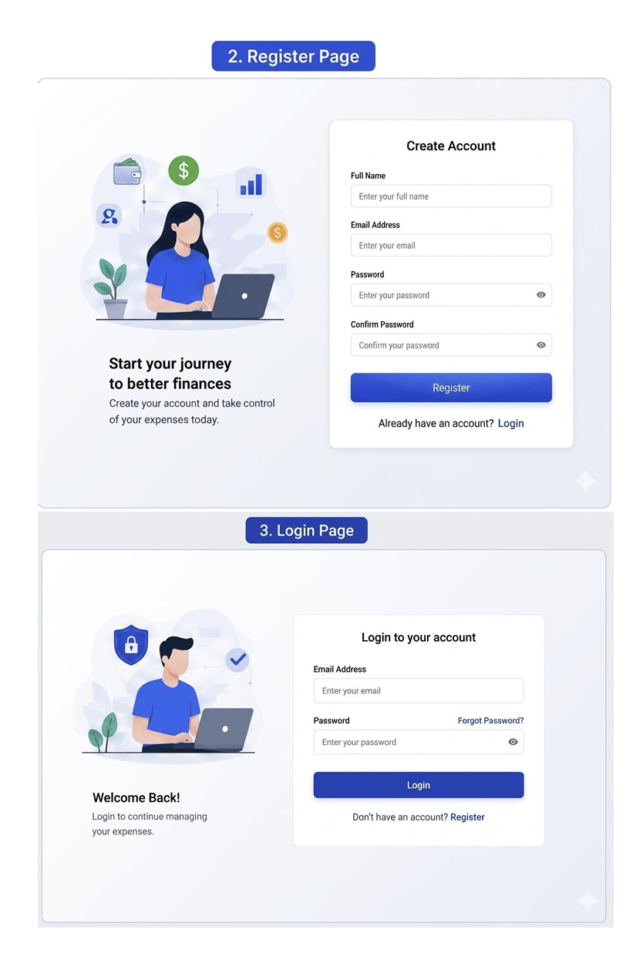

Slide 14
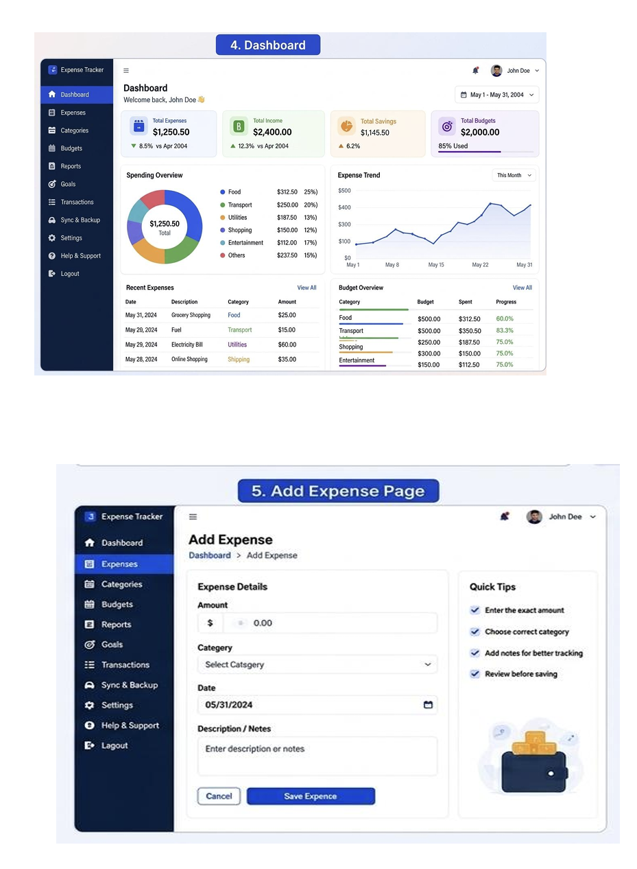

Slide 15
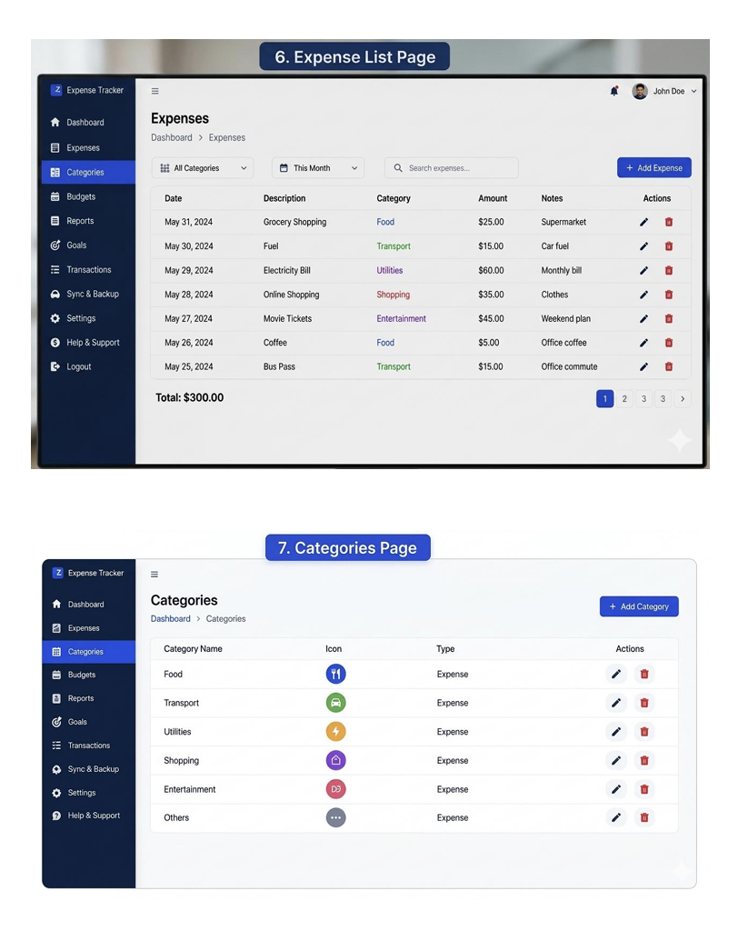

Slide 16
